Slide 1
Why Best Practice Doesn’t Work In Practice The political challenge of anti-corruption Anh Le IED Intern

Slide 2
challenges

Slide 3
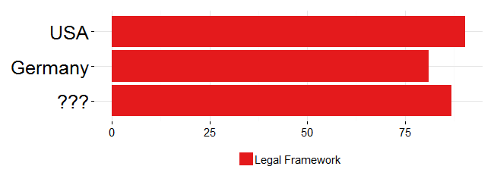
Let’s guess this Asian country
Source: Global Integrity Report (2011)
Notes:
Scoring anti-corruption legal framework of 31 countries

Slide 4
Not Hong Kong
Not Singapore

Slide 5
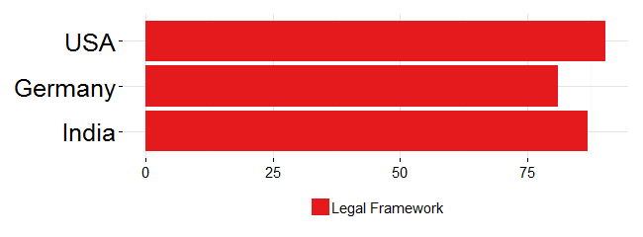
It’s . . . . .
Notes:
perfect anti-corruption law, which criminalizes bribery, extortion, and misuse of public assets
a host of supporting institutions, including a national ombudsman protected by law against political interference
an independent agency with the legal mandate to address corruption, whose leader can only be removed by the head of a democratically elected government based on an inquiry by the Supreme Court

Slide 6
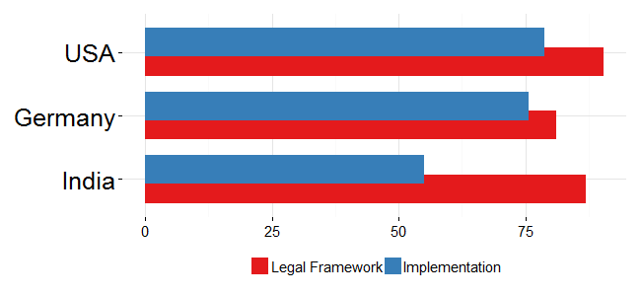
Here is a fuller picture

Slide 7
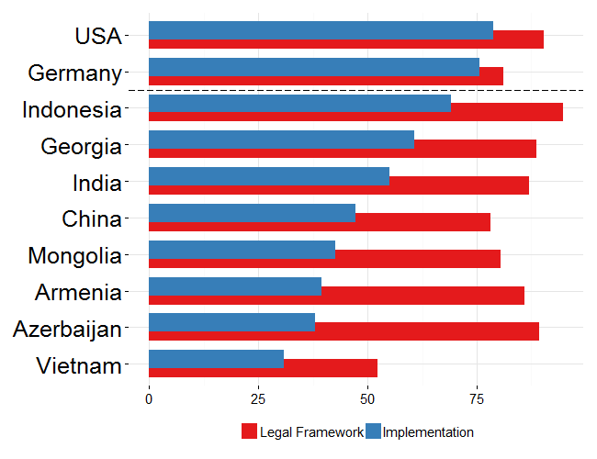
An even fuller picture
Notes:
All countries have a legal framework comparable to that of OECD countries
However, implementation is universally worse in ADB member countries, with the exception of Indonesia being a moderate success
KEY: our effort does pay off – look at the red bars – the corruption persists, and the problem is in the blue bars.

Slide 8
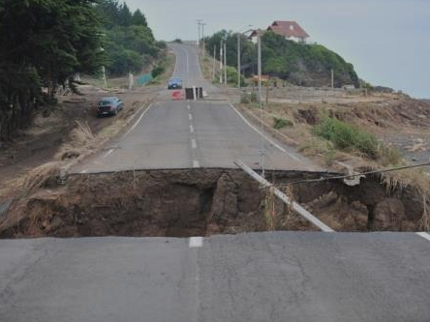
Challenge #1: Implementation gap
“…budgets are better made than executed, practice lags behind the creation of processes and laws.”
(Andrews 2010)
Notes:
Lacking political will is the foremost reasons of implementation gap
Resource may be an issue, but it’s often the allocation, the dedication of resource that is the problem, not the overall resource available (ADB’s loan are small compared to countries’ resources anyway)

Slide 9
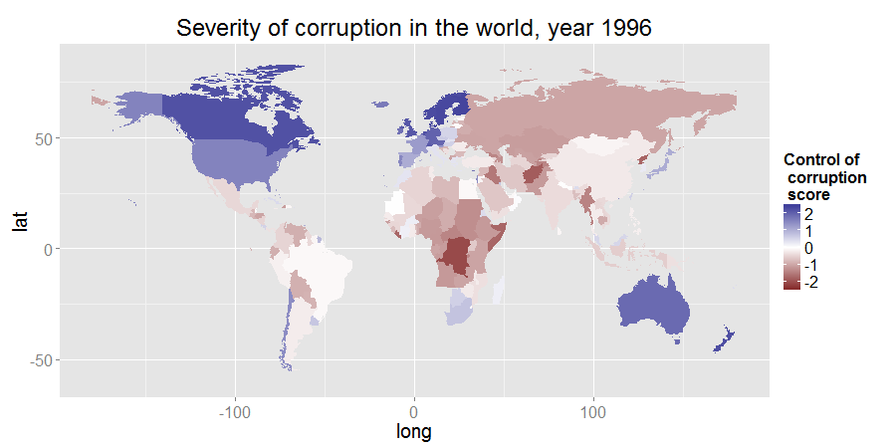
Source: World Governance Index

Slide 10
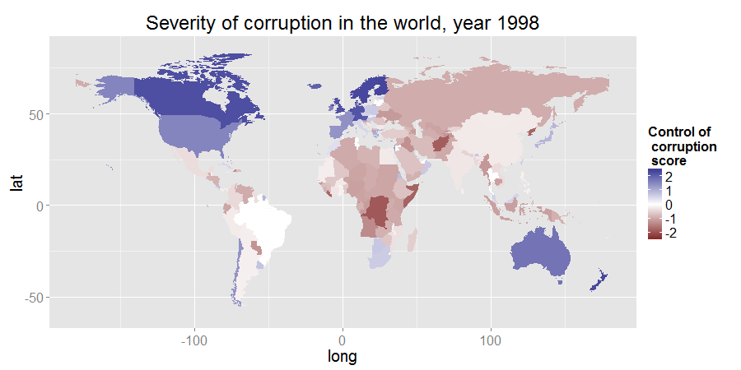
Source: World Governance Index

Slide 11
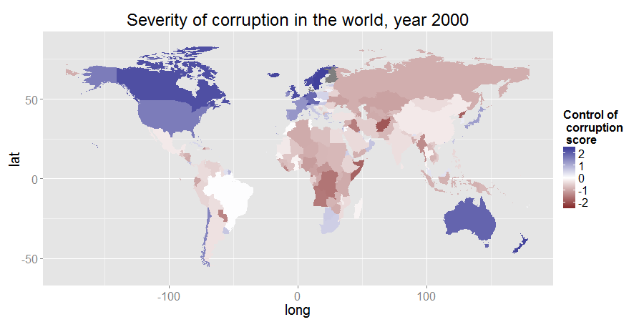
Source: World Governance Index

Slide 12
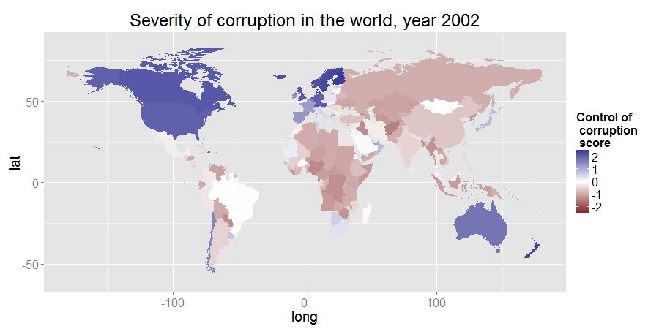
Source: World Governance Index

Slide 13
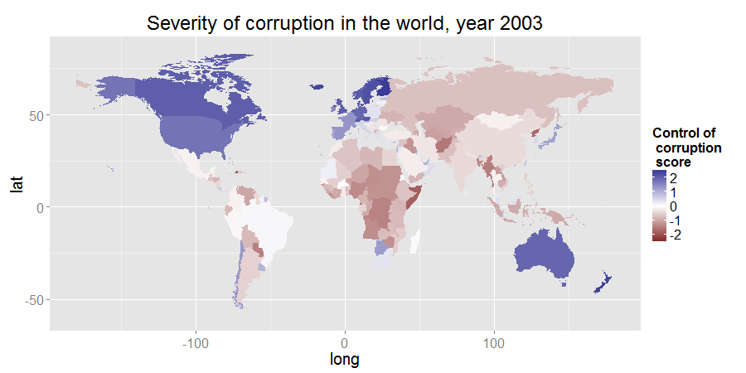
Source: World Governance Index

Slide 14
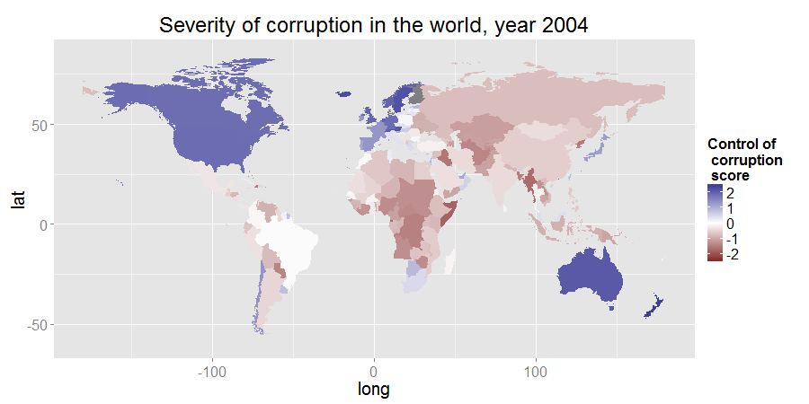
Source: World Governance Index

Slide 15
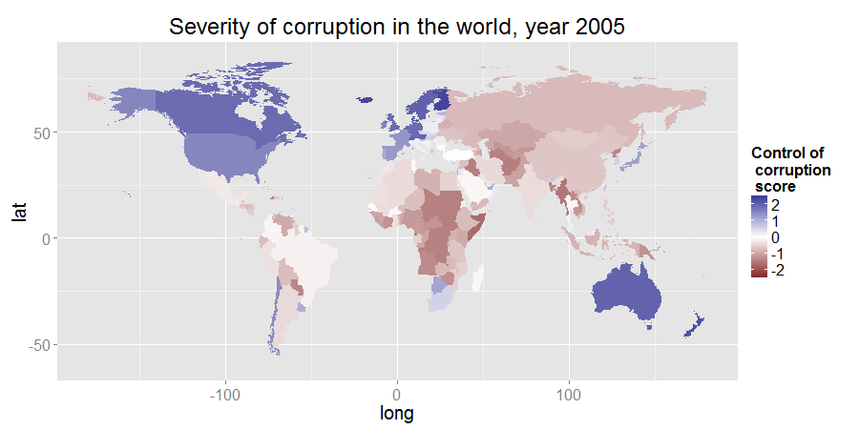
Source: World Governance Index

Slide 16
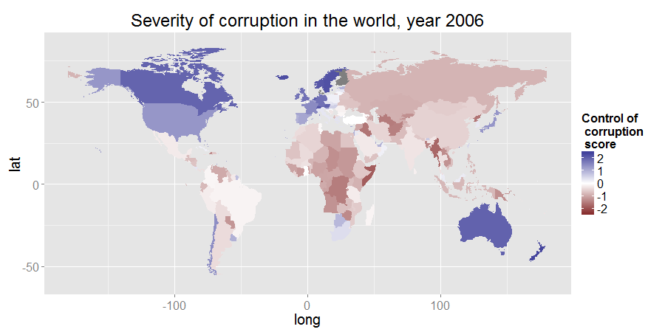
Source: World Governance Index

Slide 17
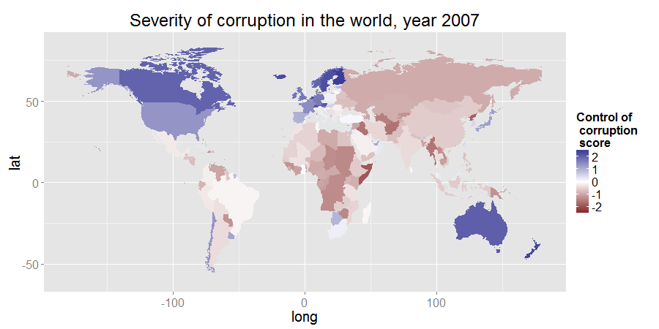
Source: World Governance Index

Slide 18

Source: World Governance Index

Slide 19
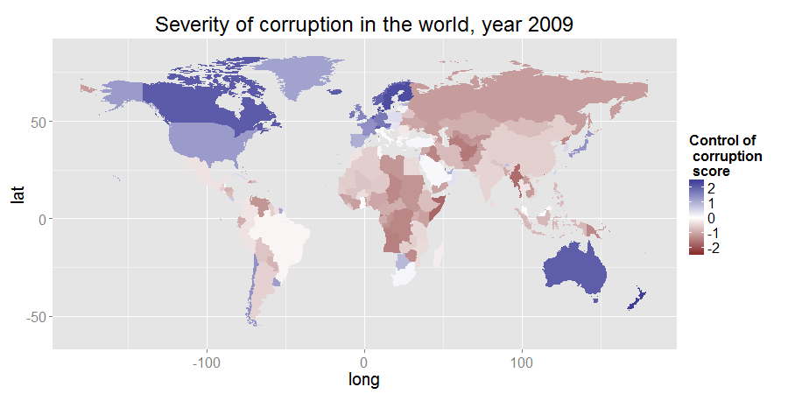
Source: World Governance Index

Slide 20

Source: World Governance Index

Slide 21

Source: World Governance Index

Slide 22
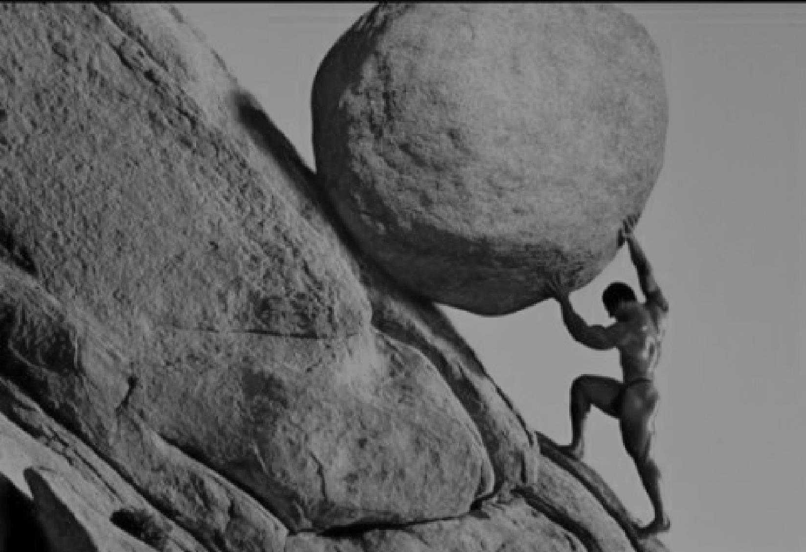
Challenge #2:
Reform reversal
“… the weak states would take hundreds, if not thousands, of years to acquire state capability.”
(Pritchett et al. 2010)

Slide 23
Notes:
- Our effort did pay off. Laws did get passed. Modern bureaucratic processes and institutions did get created. So we are successful, but only in the sense that improved laws but not improved lives is a success, and that development after hundreds of years is good enough.

Slide 24
Why?
Why?
Notes:
But as committed organization and passionate professionals, of course that’s not good enough for us. At this point, we are burning with the question “Why?”

Slide 25
explanation

Slide 26
Our framework
The reality

Slide 27

Isomorphic mimicry –
“adopting the camouflage of organizational forms that are successful elsewhere to hide their actual dysfunction.”
(Pritchett et al. 2010)
Notes:
Agencies like ADB have great influence over the form—the law making, the process—but little over the function, the implementation, which is very hard to monitor. Without seeing there is no influencing.
Attempt to actually influencing the function of the organization will touch upon the real, the material interest of officials. It is no longer just things on paper, and thus there will be much greater resistance.

Slide 28
Our framework
The reality

Slide 29
Voters do not punish corrupt officials at the ballot box

Slide 30

Results from Randomized Controlled Trials
“Parents may be too pessimistic about their ability to influence the system even if they are willing to take an active role, or parents may not be able to coordinate to … influence the system.” - India
(Banerjee 2010)
Notes:
- Providing information and the institution of participation alone is not sufficient. (mobilization actually succeeded, many people attend meetings to discuss the local educational system / volunteer to teach)

Slide 31
Results from Randomized Controlled Trials
“… grass-roots monitoring may be most effective when a subset of people personally stand to gain from reducing corruption, and therefore have strong incentives to monitor actively.” - Indonesia
(Olken 2005)

Slide 32
so what?

Slide 33
So we need to build political will …

Slide 34
So we need to build political will …
but politics is messy

Slide 35
solution

Slide 36
Indicators and Benchmarks (IB)
Performance audit across peer units
Notes:
Example: Let’s say that we collect data on the expenditure on standard medical equipment. We find that hospital A routinely spends 20% more than market price, hospital B spends about the same, and hospital C manages to spend less.

Slide 37
Indicators and Benchmarks (IB)
Performance audit across peer units
Repeated, publicized, actionable
Notes:
- We may do the same data collection on other dimensions of performance. We then widely publish the result, visibly commend high performance units, and repeat the exercise annually. As the results accumulate over years, we can focus more on comparing a unit with its past performance rather than with its peers.

Slide 38
Indicators and Benchmarks (IB)
Performance audit across peer units
Repeated, publicized, actionable
Immediate impact on people’s welfare
Notes:
That kind of diagnostics has value in and of itself, because it points to bottlenecks of governance, shows us where attention is needed most.
But furthermore, back to our concern with political will, this strategy can also arouse the public interest

Slide 39

Tip each individual’s cost-benefit balance into joining our cause

Slide 40
Indicators
Quality of infrastructure
Expense on standard goods
Time for routine process

Slide 41
Benchmarks
BEST: A unit’s own past performance
Norm in other units
Private sector
Statistical model

Slide 42
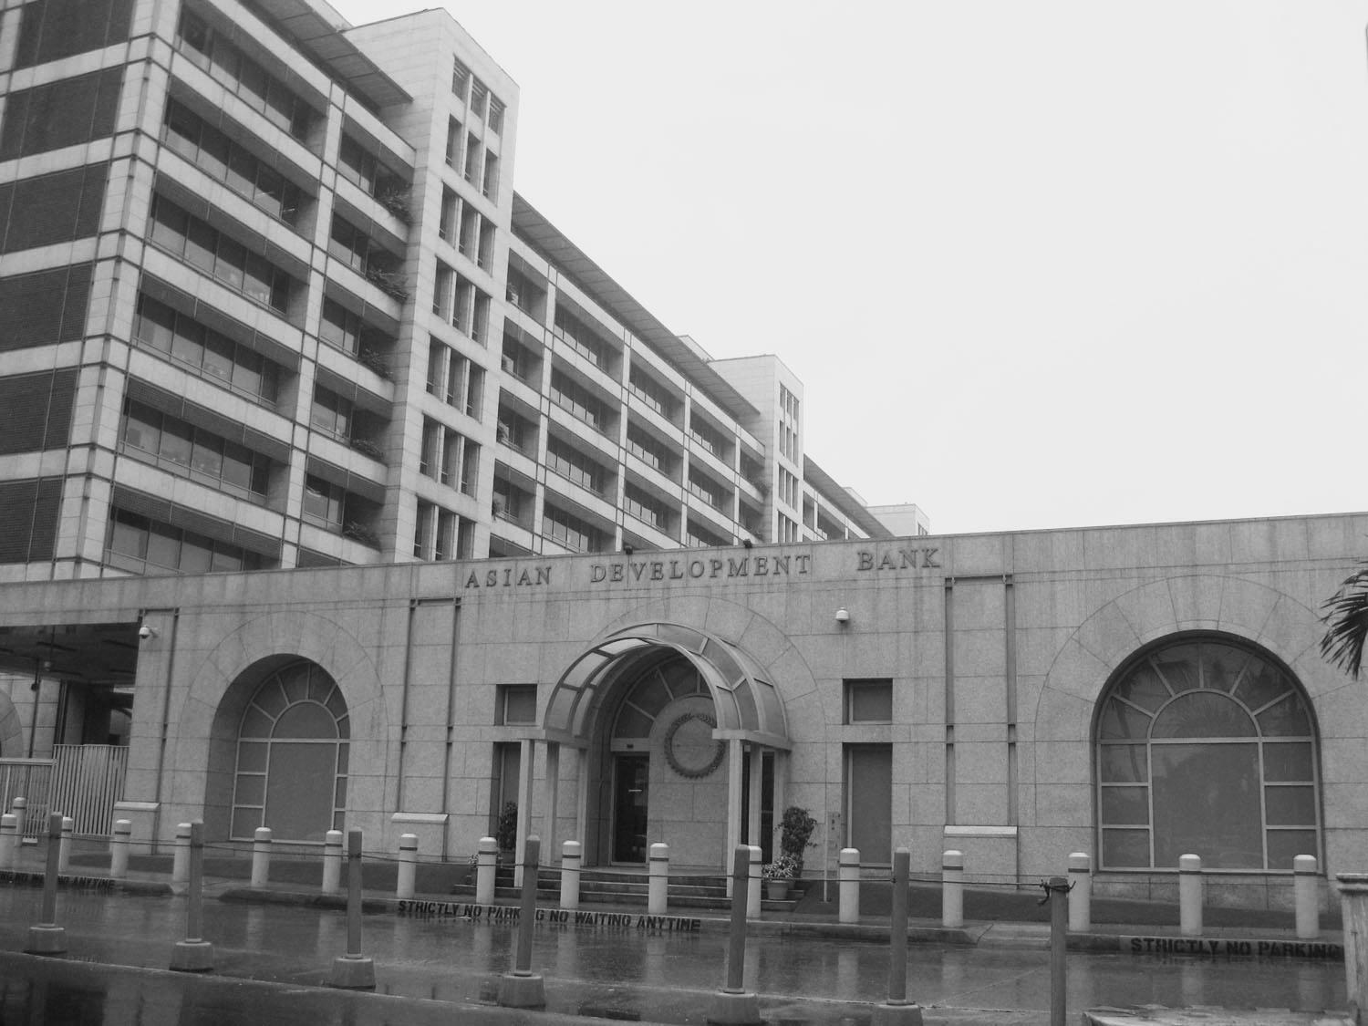
No mention of the c-word
Routinized implementation
Ready capability

Slide 43
Political economy analysis
Deep country knowledge
Notes:
PE analysis: not necessarily the formal kind, which easily slips into a check-the-box exercise. PE analysis that aims towards identifying real commitment / constituency for reforms (a good way to operationalize this)
Deep country knowledge: we don’t need the best guy on governance in Manila, then flying to all countries giving best practices. We need people on the ground, sticking to that country for a long time

Slide 44
word of caution

Slide 45

the mindset
not the tool

Slide 46
word of hope

Slide 47


